Slide 1

Multi-Player BlackJack Game
Daniel Jensen, Chun Yin Lee, Aastha Sharma

Slide 2
01
Project topic
02
Important Requirements
03
Overall Design
04
Class UML diagrams
05
Message passing
06
Demonstrate
07
Hindsight lesson

Slide 3
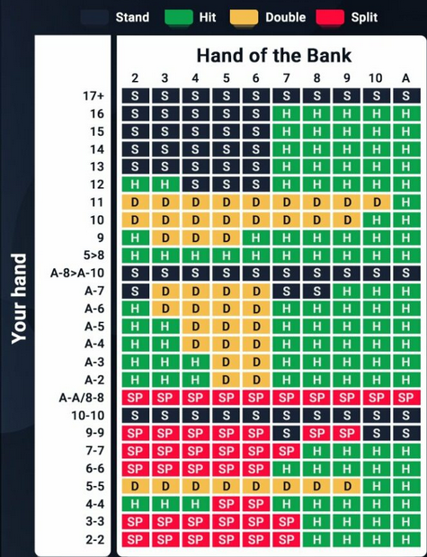
Project Topic
Multi-Player BlackJack Game
The multi-player blackjack game is a game designed for anyone that wants to play blackjack with other real players online. The game supports multiple people playing together, or one person playing against the house. This is a java based project, in order to allow the widest compatibility with user computers.

Slide 4
Important Requirements
Common Requirements:
Users should have login credentials to connect to server from client.
Users should be allowed to play together in groups of max size 5.
Users should be able to add and withdraw funds from their account.
Users should not be able to cheat.
Users cannot have more than one account.
Company/Casino Module Requirements:
The server should create multiple games to handle additional players after a game is in progress or full.
Users should not be allowed to join games already in progress. Player total in each game will shrink until all players leave.
The Player Module Requirements:
Players should be allowed to play together in groups of max size 5.
Player can only be logged into one client at a time.
Player can only play in one match at a time.
Players should be able to log out whenever.
Player must place a bet
The bet that a player placed must be more than or equal to their account balance
4. The Dealer Module Requirements:
Dealer can only be logged into one client at a time.
Employee (dealer) accounts will not track a balance.
Only one dealer will be permitted per table. A dealer will only work at one table.
Dealer must not permit or participate in any cheating
5. External Interface Requirements:
The system must provide an interface to our payment system so that players can add funds and withdraw funds as needed. The interface is to be in a comma-separated text file containing the following fields: player id, current balance, amount of money being moved, action. Where “action” is whether the user has added or withdrawn the funds. The file will be exported nightly and will contain new transactions only.
The system must provide an interface to our logging system so that all game moves and cards are logged to prevent cheating. The interface is to be in a comma-separated text file containing the following fields: player id, current balance, amount bet, status in game (in or out), action (hit or stay), cards in hand. The file will be exported after every game session (table) closes.
6. Internal Interface Requirements:
The system must process a data-feed from the logging system so that all game moves and cards played are stored to prevent cheating. The data feed is to be in a comma-separated text file containing the following fields: player id, current balance, amount bet, status in game (in or out), action (hit or stay), cards in hand. The file will be exported after every game session (table) closes.

Slide 5
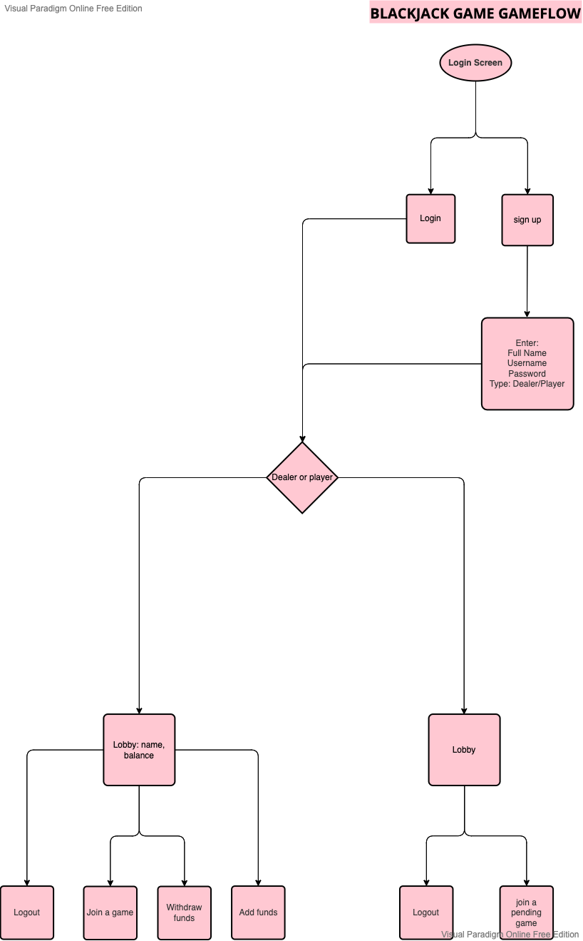
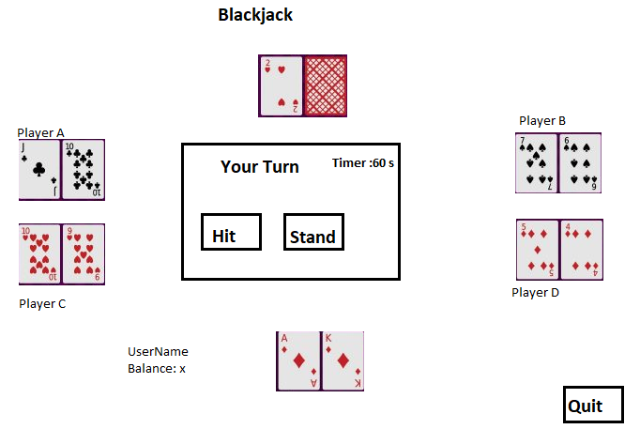
Overall Design
This Multi-Player Blackjack game combines several subprograms: login page, game room and online bank. Login page is for the player and dealer to log in. After that, player can access their online bank to add/withdraw funds or they can get in the queue to join a game. Finally, they can play in the game room. Card and deck are the elements for the blackjack game.

Slide 6
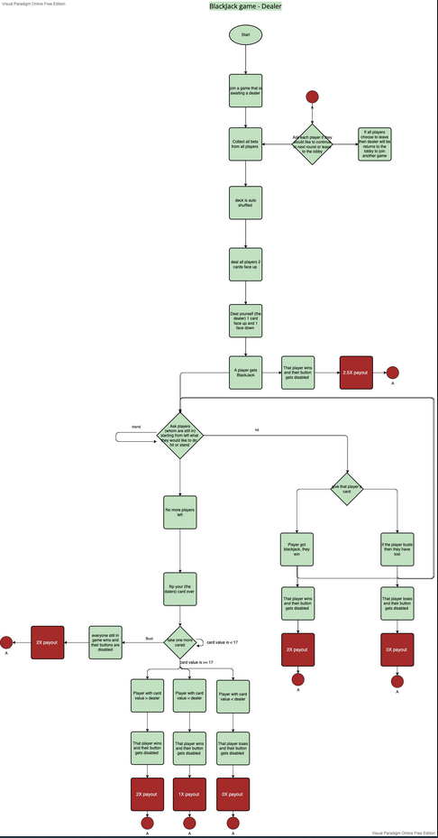
Blackjack Game - Dealer
https://ibb.co/9477jjT

Slide 7
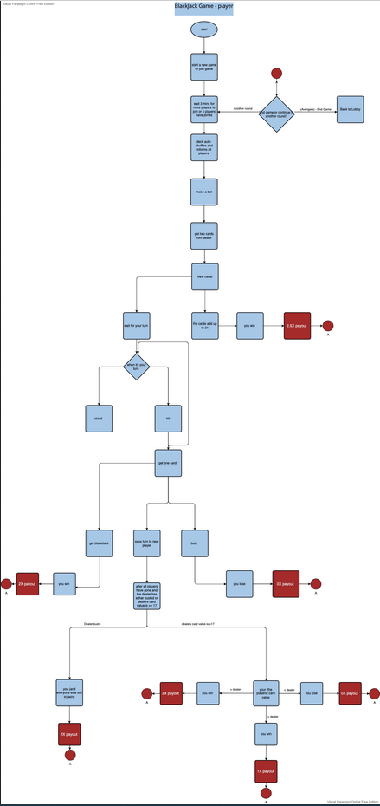
Blackjack Game - Player
https://ibb.co/pJ5m4Q9

Slide 8
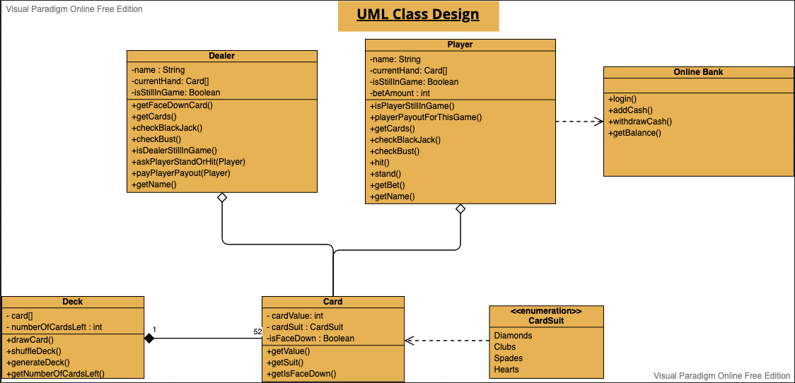
Class UML diagrams
Card – a single card represents for a rank and suit
It combines from one of the thirteen ranks (from 2 to 10, Jack, Queen, King, and Ace), and one of the four suits (diamonds, clubs, hearts, and spades). Therefore, each item will contain one rank and one suit. No duplicates will occur.
Deck—a deck combines all 52 cards
It is a list of all 52 cards in a particular (random) order, and the number of cards will decrease by dealing out cards to dealer and player hands. When the game is done, it will reset as a full deck and be shuffled.
Online Bank – for the players to add/withdraw the funds to their account
It requests a text file to save the balance of their account every time while they add/ withdraw the funds from their account. Also, during the game, the system will load this record to let the player know what their current balance is and will update when the game ends.

Slide 9
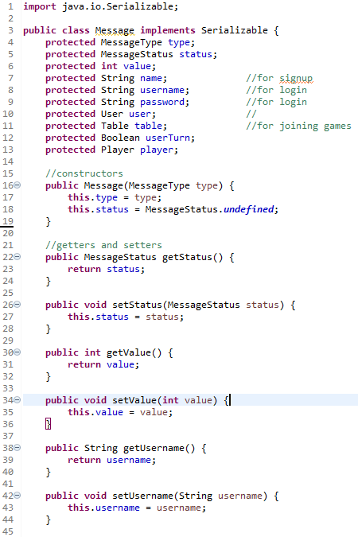
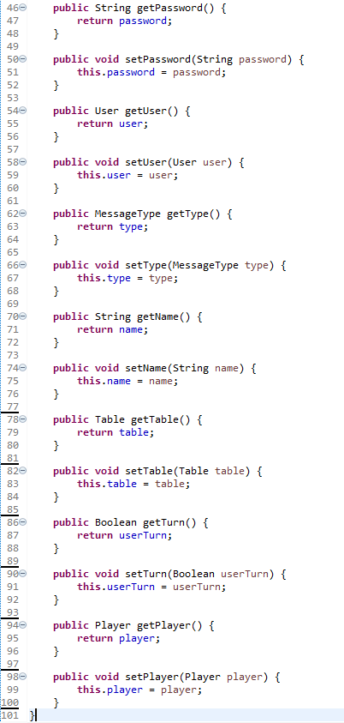
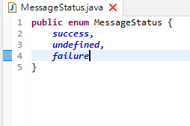
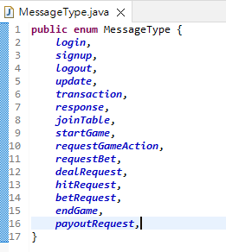
Message passing

Slide 10
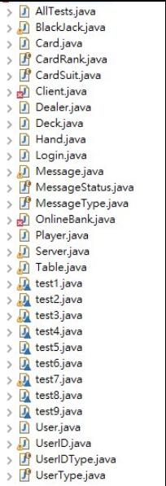
Demonstrate

Slide 11
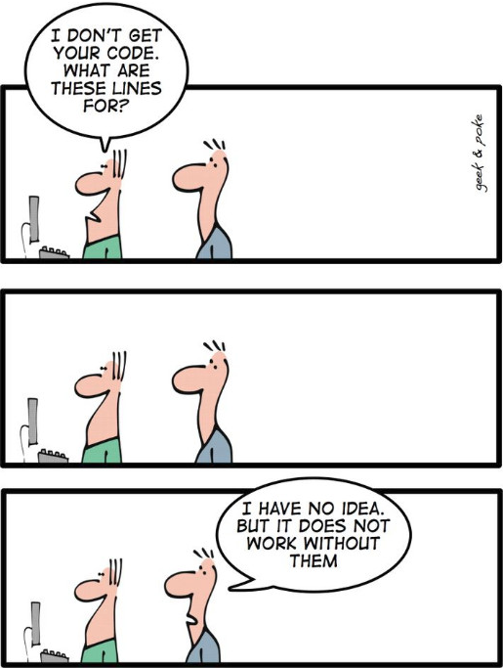
Hindsight lesson
It is difficult to work with others, since its hard to look at the code from other and take over to finish it
Every subprograms seem work fine, but the difficult part is combined into a program and send between the server and client
Simple is the best, sometimes we think too complicated
Running out of time, as one week is not quit enough
Split the work should more evenly to ensure it all worked

Slide 12
github
https://github.com/DanielUniqueLettersHere/CS401_Group5_BlackJack

Slide 13
Thank You

